Slide 1
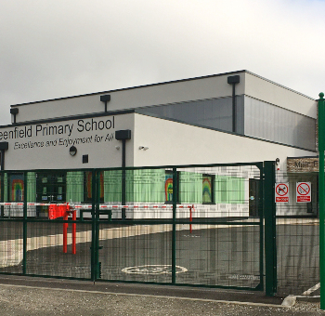

Greenfield Primary
School PTA
Annual General
Meeting (AGM)
Celebrating achievements and planning future initiatives together

Slide 2
AgendA
Agenda Item | Details
Welcome | Brief welcome to the meeting
Introductions | Around the room & virtually to quickly introduce ourselves: Name, Child’s name and Class
PTA Roles | Roles available: PTA_Roles.pdf
Review of Last Year
Key purchases | Reception gifts, Books, resources, Christmas gifts, Outdoor Classroom, Medieval Day, Easter prizes, Music Festival entrance fees, VE Day dance workshop, Y6 Bowling Trip, Library Refresh, music stands
Key events | Spooky Disco, Fashion Show, Film Night, Christmas Fair, Santa Dash, Valentines Cake Sale, Mother’s Day Secret Room, Non-uniform days, Chocolate Bingo, Father’s Day Secret Room, Summer Fun Fest
Financial Update | Led by Treasurer, Rebecca Rose Outstanding Invoice: Cleaning Equipment for Sam?
This Year So Far
Reception gifts | Books purchased and handed out 09/09
Reception Coffee morning | To be held 12/09
Requests Received
History Day funding request | £1,100 requested, this year’s theme is World War I Day (last year it was Medieval Day – the cost is the same)
Books request from Miss Humphries for Guided Reading | £1,624 requested for the full set of missing texts
Boarshurst Band performance at school | Adele leading on organisation of this
Spending proposal for PTA storage | Storage unit required on school grounds

Slide 3
AgendA
Agenda Item | Details
Upcoming Events
Spooky Break Rules Day | Date proposed – Friday 17th October
Spooky Disco | Date proposed – Friday 24th October
Other proposed events | Open discussion
Santa Dash | Saturday 6th (Organising Committee required)
Christmas Jumpers Day | Date proposed - Thursday 11th December
Christmas Fair | Date proposed – Saturday 13th December
Pictures on cards/mugs | Do we want to participate? (Not APFS)
Any Other Business
Thanks and Close | Meeting ends, except for those who want to be part of the Spooky Disco planning group
Additional Meeting Agenda: Spooky Disco Planning
Confirm activities required & owners | Review full plan
Confirm Volunteers | Confirm how many volunteers required and plan to request support
Confirm next steps
Close

Slide 4

Welcome & Introductions
Around the room & virtually to quickly introduce ourselves:
Name
Child’s name and Class

Slide 5

Opportunities to Join and Contribute to the PTA
Roles available:
Chair
Vice Chair
Secretary
Communications Officer
Volunteer Coordinator
Notes:
---
Whether you have time to volunteer, ideas to share, or skills to offer, there are many ways to contribute meaningfully to the PTA’s efforts.
Image source: Microsoft 365 content library

Slide 6
How Funds Have Been Allocated to Benefit the School
Enhancing Student Learning
Funds were allocated to improve educational resources and support diverse learning opportunities for students
Reception gifts, Books, resources, Christmas gifts, Medieval Day, Easter prizes, music stands, Library Refresh.
Improving Facilities
Investments were made to upgrade school infrastructure, creating better environments for students and staff
Outdoor Classroom.
Supporting School Programs
Funds support extracurricular and enrichment programs that contribute to the holistic development of students.
Music Festival entrance fees, VE Day dance workshop, Y6 Bowling Trip
Notes:
---
Funds raised have been thoughtfully distributed to enhance student learning, improve facilities, and support school programs that benefit all students.
Image source: Microsoft 365 content library

Slide 7
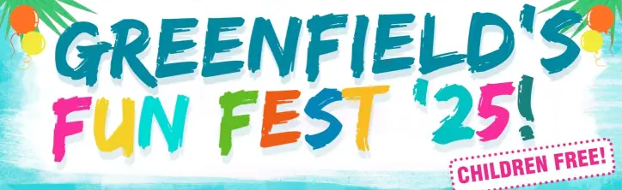


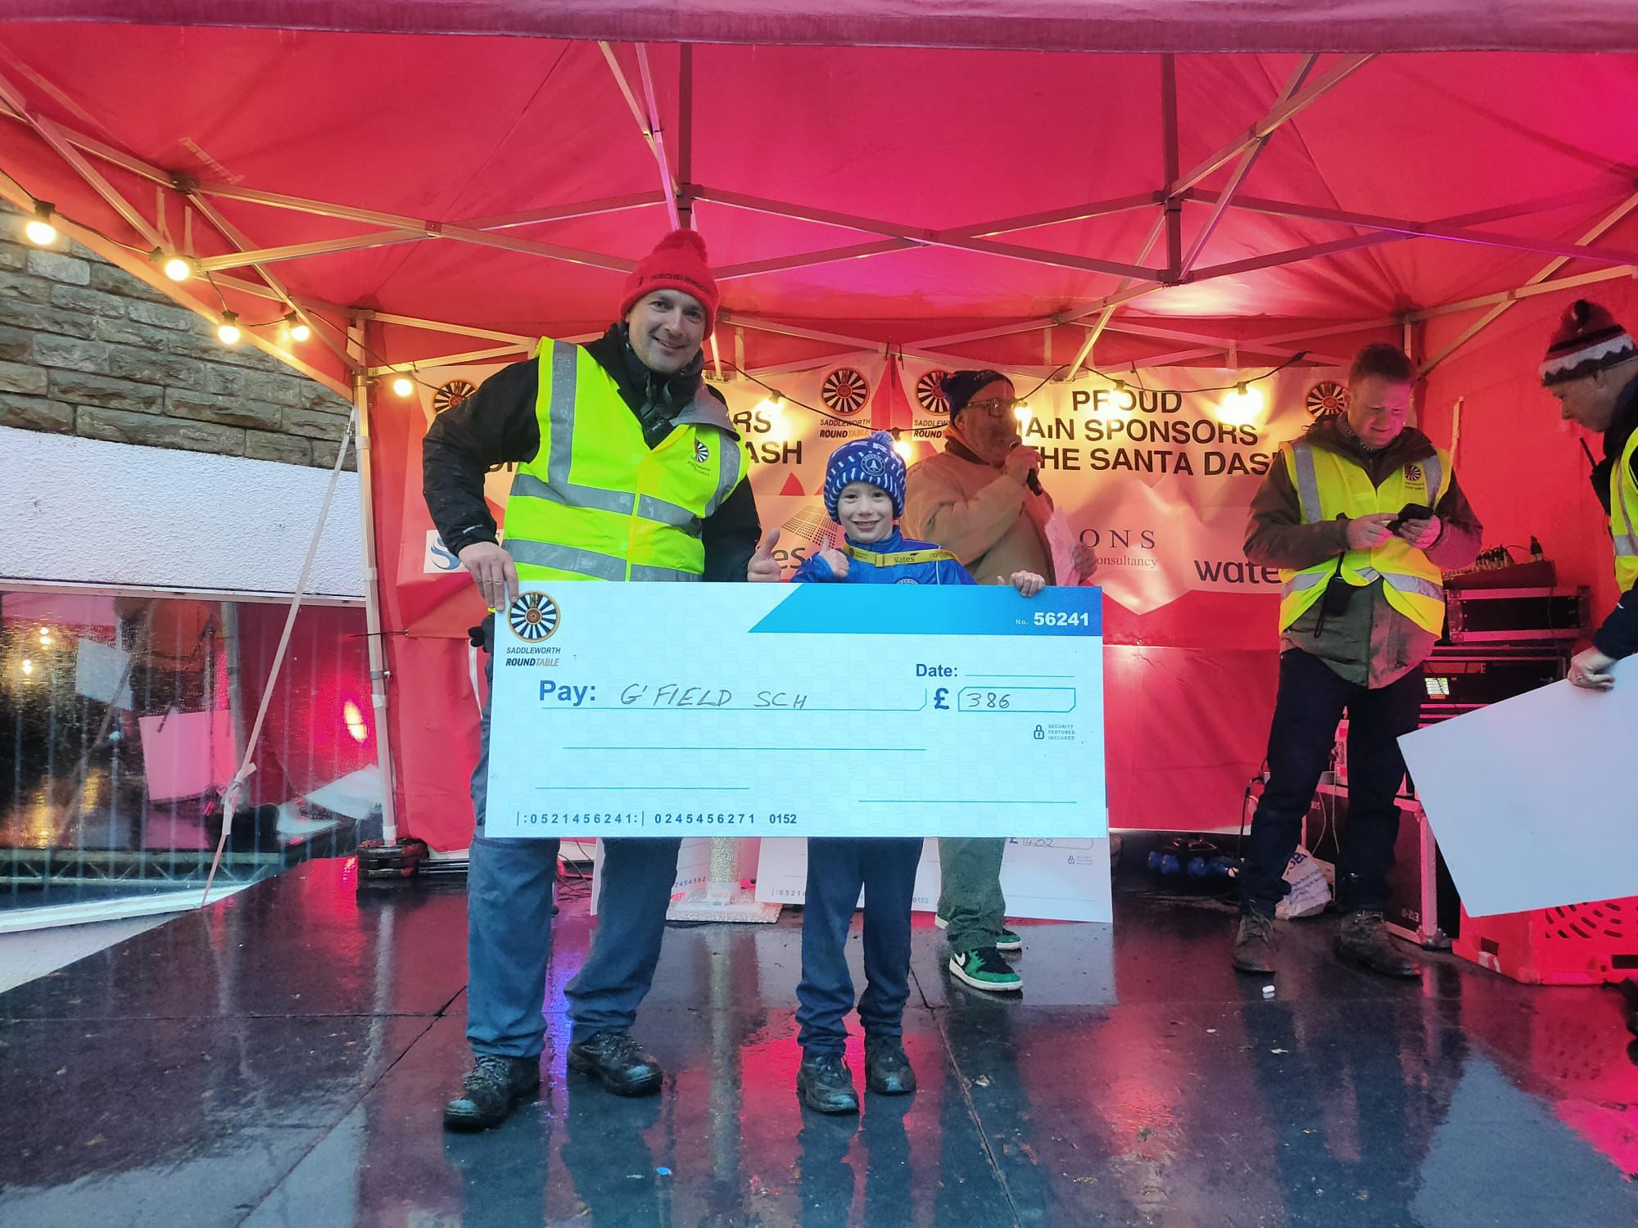
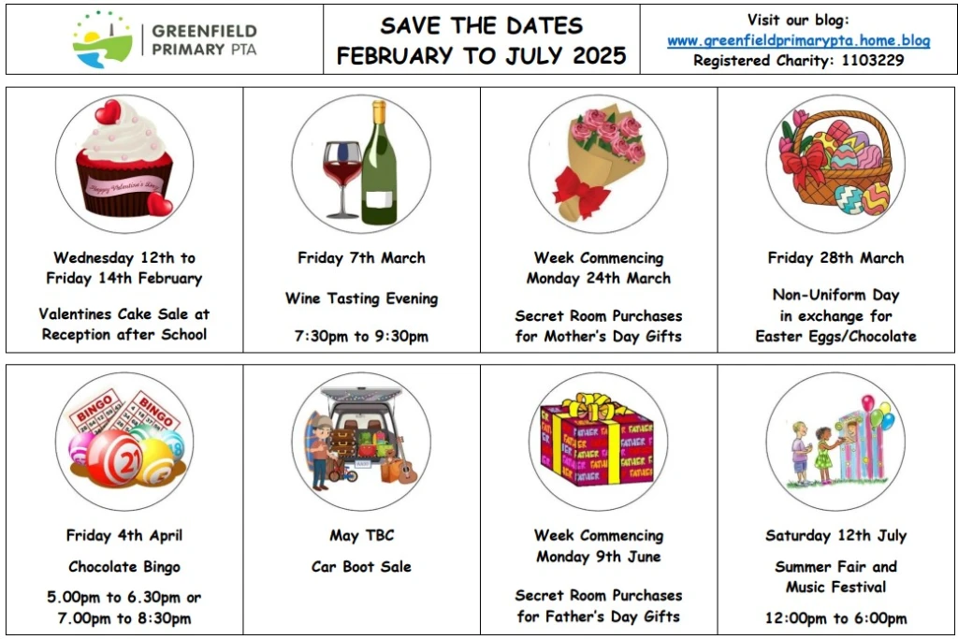
PTA Event Support Highlights
Fundraising Initiatives
  The PTA organized successful fundraisers such as the Spooky Disco, Fashion Show, and Film Night to support the school.
Seasonal Celebrations
  Events like the Christmas Fair, Santa Dash, and Summer Fun Fest were organized to bring joy to students and families.
Creative Event Themes
  Themed sales and secret rooms were arranged to celebrate special days, fostering excitement and school spirit among students.
Notes:
Image source: Microsoft 365 content library
The PTA has played a vital role in supporting a variety of school events. They organized fundraisers such as the Spooky Disco, Fashion Show, and Film Night, enhancing community spirit. Seasonal celebrations like the Christmas Fair, Santa Dash, and Summer Fun Fest were made possible through their dedication, along with themed sales and secret rooms to celebrate special days.

Slide 8

Financial Update
Spends
Outstanding invoices
Total in account

Slide 9

This Year so far
Reception gifts
Books purchased and handed out 09/09
Reception Coffee morning
To be held 12/09
Notes:
---
We have a number of initiatives and events planned for the coming year designed to engage the community and raise vital funds for the school.
Image source: Microsoft 365 content library

Slide 10

Requests Received
Request | Details
History Day funding request | £1,100 requested, this year’s theme is World War I Day (last year it was Medieval Day – the cost is the same)
Books request from Miss Humphries for Guided Reading | £1,624 requested for the full set of missing texts
Boarshurst Band performance at school | Adele leading on organisation of this
Spending proposal for PTA storage | Storage unit required on school grounds

Slide 11

Upcoming Events
Event/Actvity
Spooky Break Rules Day | Date proposed – Friday 17th October
Spooky Disco | Date proposed – Friday 24th October
Other proposed events | Open discussion
Santa Dash | Saturday 6th December (Organising Committee required)
Christmas Jumpers Day | Date proposed - Thursday 11th December
Christmas Fair | Date proposed – Saturday 13th December
Christmas Pictures on cards/mugs | Do we want to participate? (Not APFS)

Slide 12

Any Other Business?

Slide 13
Many thanks!

Slide 14
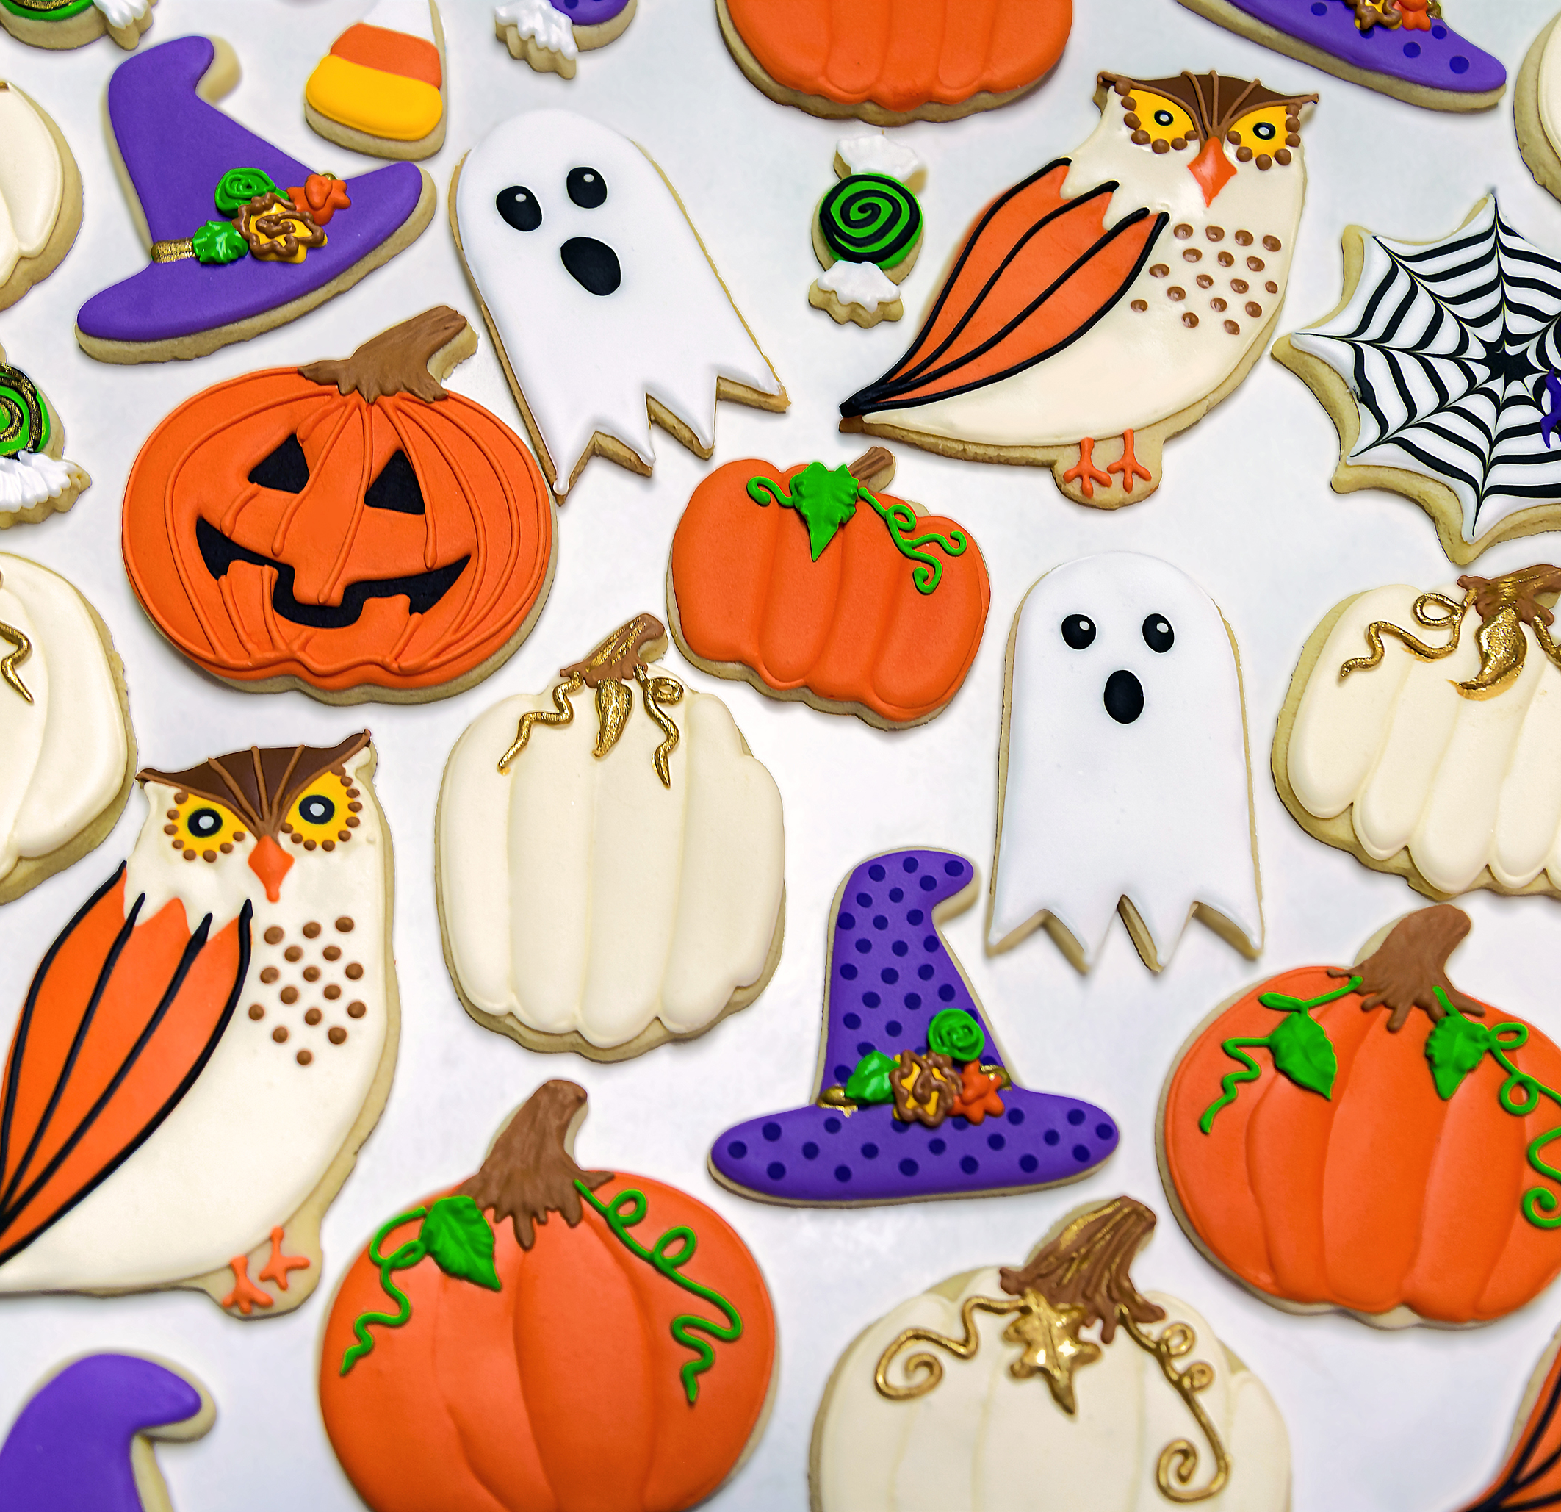
Spooky disco planning

